Slide 1

Generic Kubernetes based
load testing framework
2nd YEARS
Holly Daly - 20331814
Declan Quinn - 20334565
Miguel Arrieta - 20332427
Abdelaziz Abushark - 20332134
3nd YEARS
Aaron Byrne - 19334098
Tomasz Bogun - 19335070
Vitali Borsak - 19335086
Group 5 Client: Rapid7

Slide 2
Project Overview
Create a mock search engine that searches vast amounts of data for the specific information that is needed by the user.
Our system will then run performance tests on the piece of software and report back the results.
The test runner and project under test must be packaged up to a docker container and deployed to a Kubernetes cluster.
A user interface will then monitor and graph the performance of the system.

Slide 3
Features
1. It is a Generic service
2. It take any executable
3. It packages it up to docker container as it is automatic packaging
4. It takes configuration file with a list of HTTP command (curl or otherwise) to execute.
5. It deploys the project under test and the testing framework to Kubernetes
6. It runs the tests, collects the results in a test file
7. No need to set up huge clusters to execute a load test
8. Self healing and storage orchestration
9. Automatic Binpacking and batch execution

Slide 4
Implementation
The Work was split into 3 teams; the project-under-test team, the test-runner team, and the containerisation team
The project under test team used python and a module called flask to make a http server against which the tests will be performed.
The test runner team used Java, Apache and reported the results using JSON and Jackson API.
The Containerisation team used docker and kubernetes to isolate the project under test and the test runner.

Slide 5
Challenges Faced
Learning and understanding new technologies we have never used before
Arranging convenient meeting times for the group
Designing efficient code solutions to meet the requirements of our client
Ensuring deadlines were met
Teamwork:
2nd Years: Working together programming as part of a team
3rd Years: Managing the group and designing the system

Slide 6

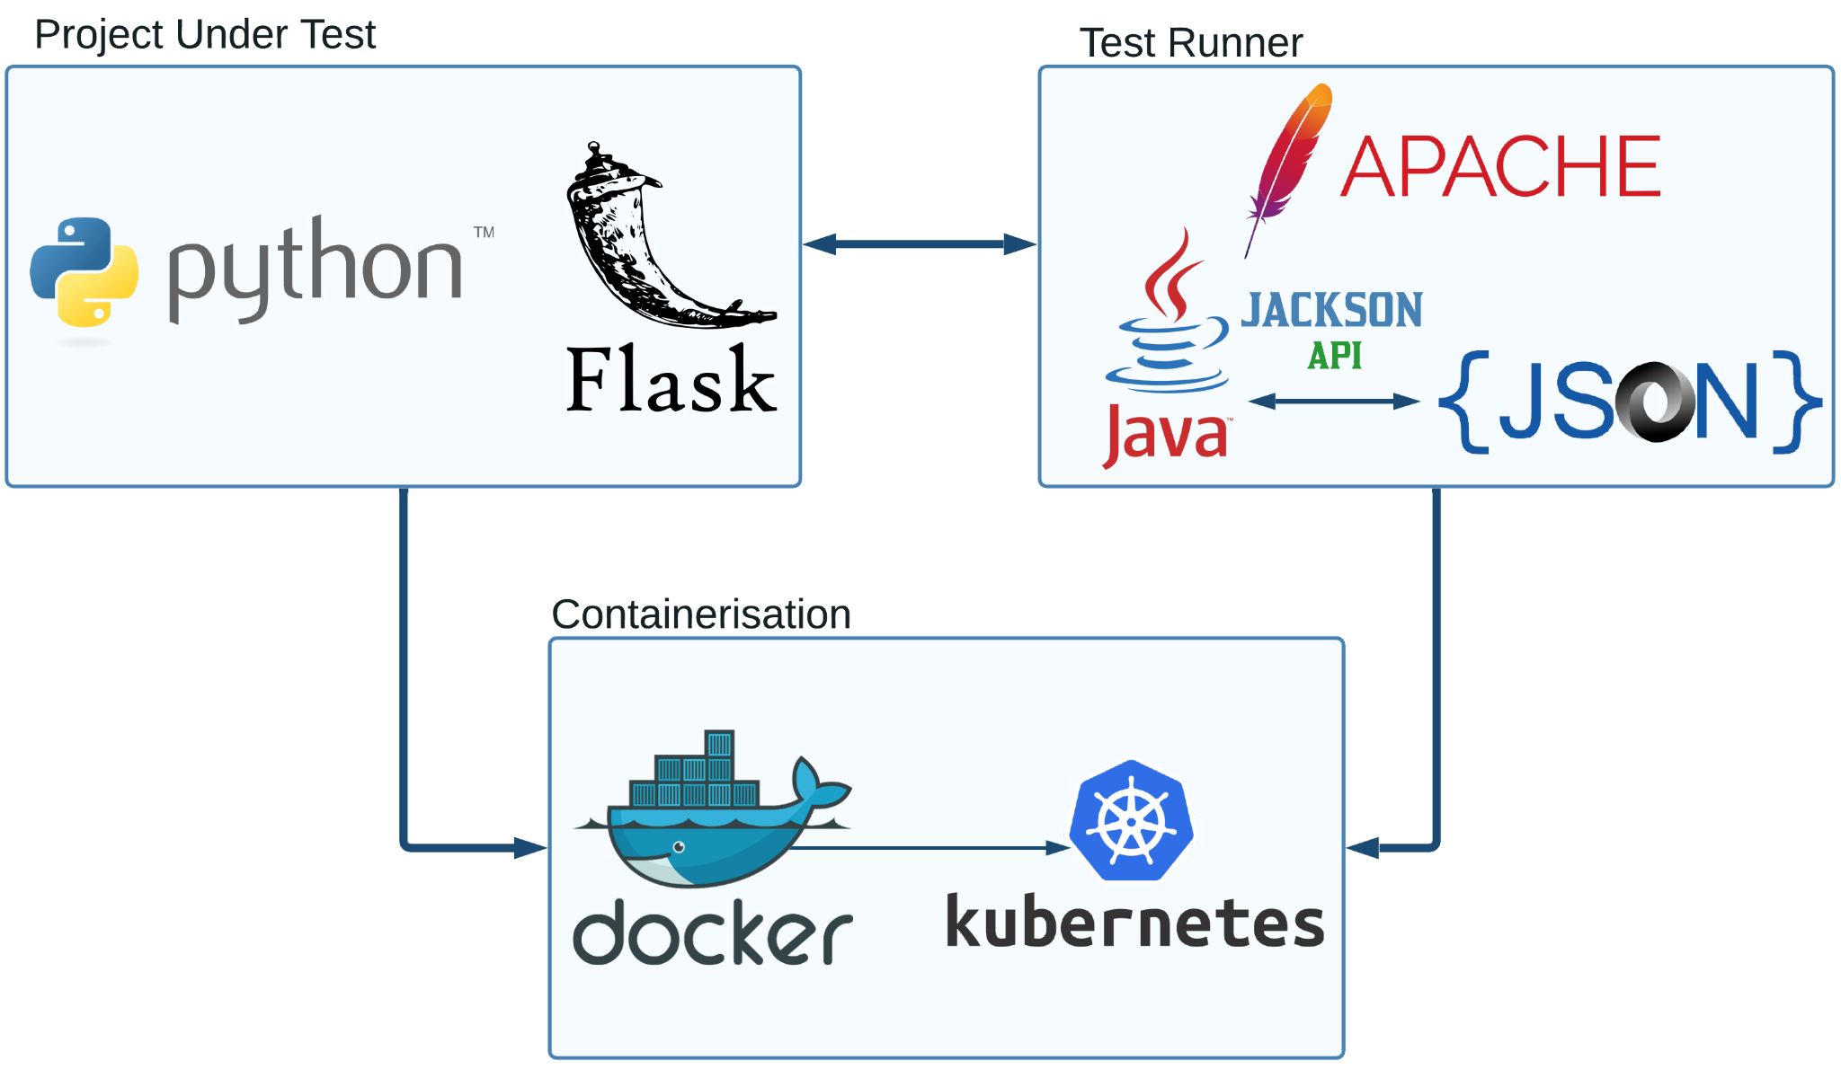
TOOLS

Slide 7
Reflection
Our team got the amazing opportunity to work for a real enterprise through a Trinity connection and with a genuine software engineer working in the field, which showed us how work in a real-life scenario would be like.
Each team member got to expand their knowledge and experience, with the second years delving deeper into the technology-side of things, and the third years getting a taste for the management role.
Due to the hybrid communication off our team, of both online and offline, it was a challenge to make sure that everything was running smoothly, which our team overcame.
Each member of the member got a greater understanding of teamwork and how important communication and planning is to make sure that there are no delays and that everything is delivered on time.

Slide 8
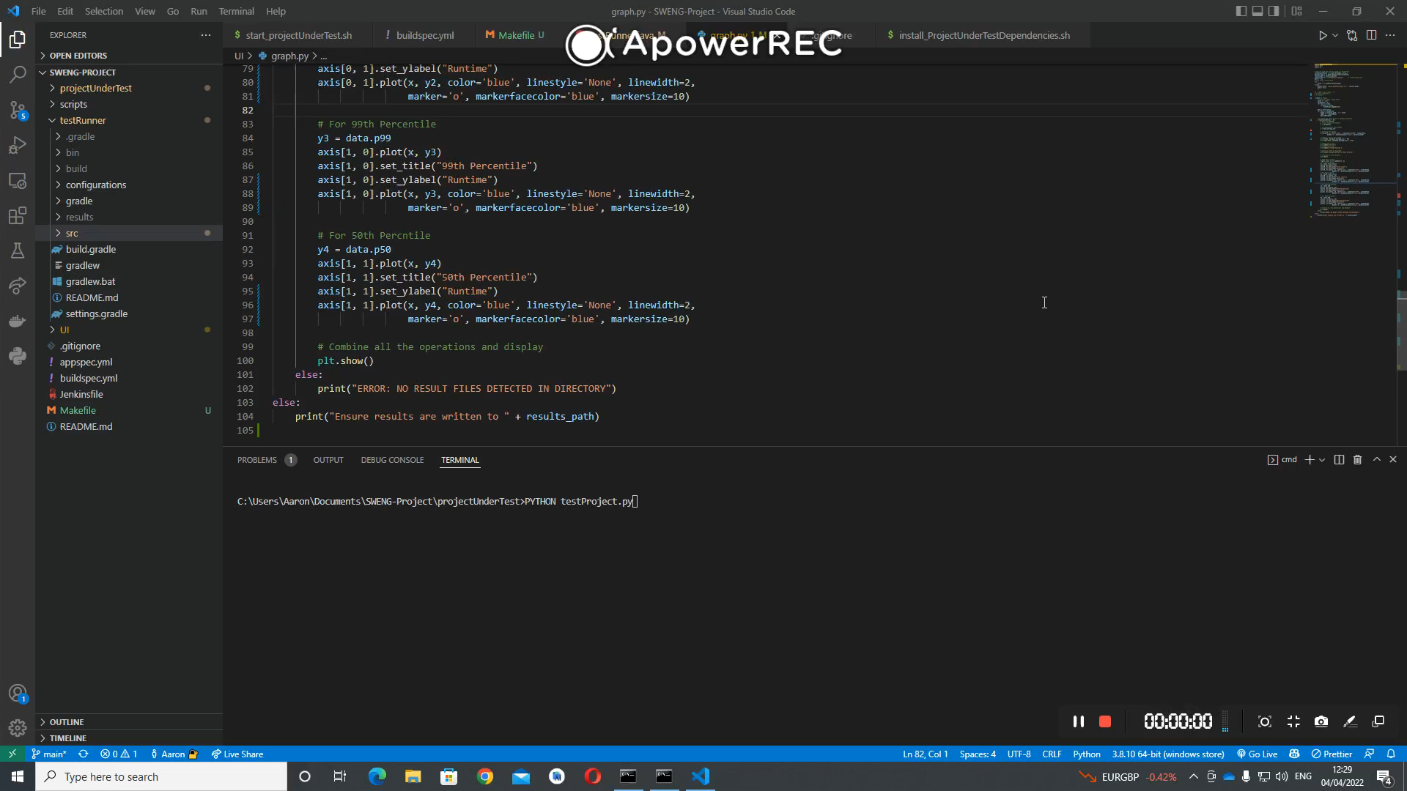
Demo

